Slide 1



NSTU
Club Collab

Slide 2
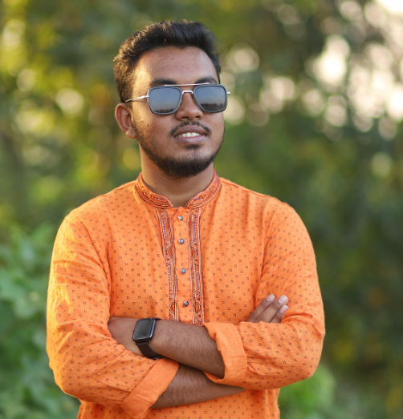
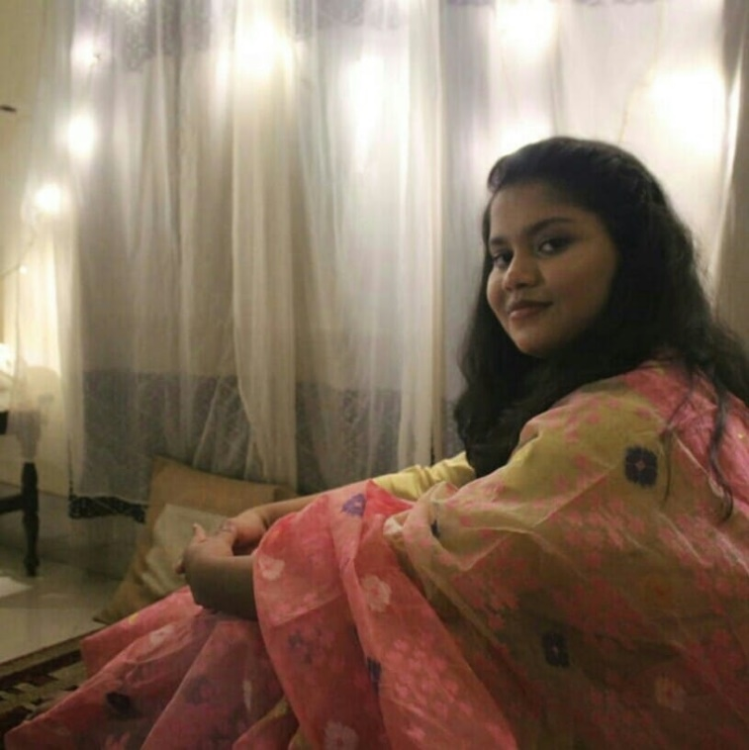
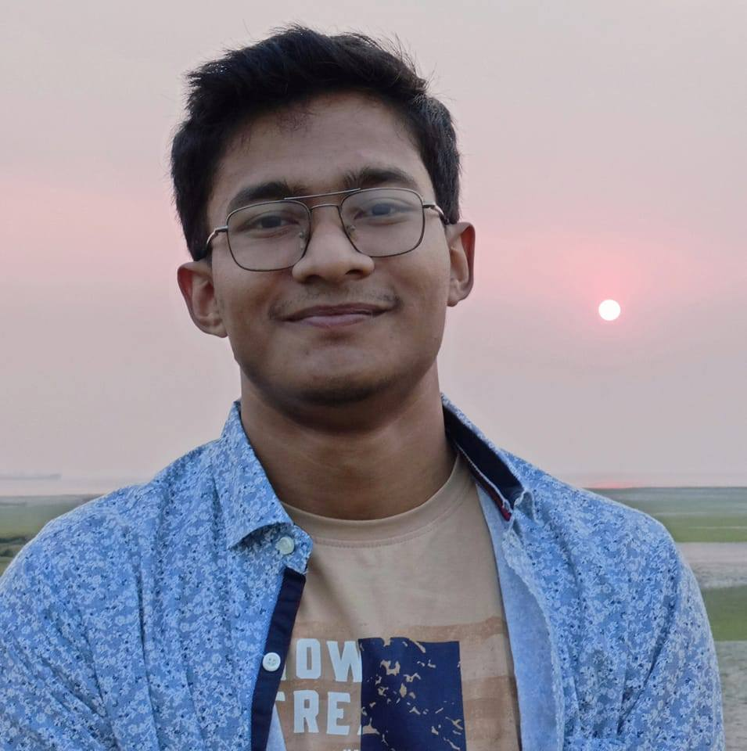
Meet Our Team
Shahriar Ahmed
shahriar2514@student.nstu.edu.bd
Ikra Chowdhury
ikra2514@student.nstu.edu.bd
Sourav Barman
barman2514@student.nstu.edu.bd
1

Slide 3

Supervised by
Tasnim Rahman
Sourav
Lecturer
IIT,NSTU
ASH19250
ASH1925030M
2

Slide 4


Today’s Agenda
1
Introduction
2
Features
3
Users
4
Team Contribution
3

Slide 5

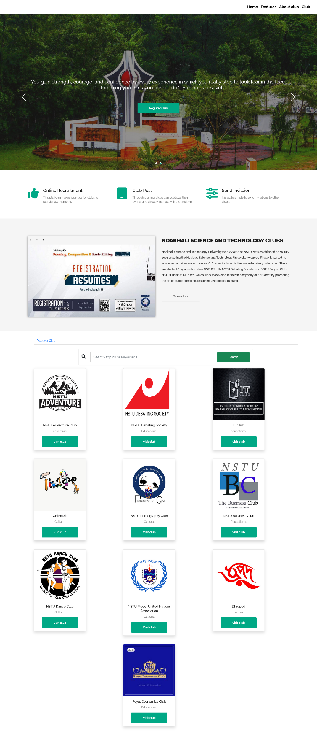
Introduction
connect all of our university's clubs on one site
making them more accessible to students
4

Slide 6


NSTU Club Collab
Features
Recruit new members
Manage members
03
04
02
05
Pay monthly fee
sends invitations
NSTU Club Collab
01
06
Manage post
Club’s payroll
5

Slide 7


NSTU Club Collab
Users
Students
NSTU Club Collab
Teachers
6

Slide 8

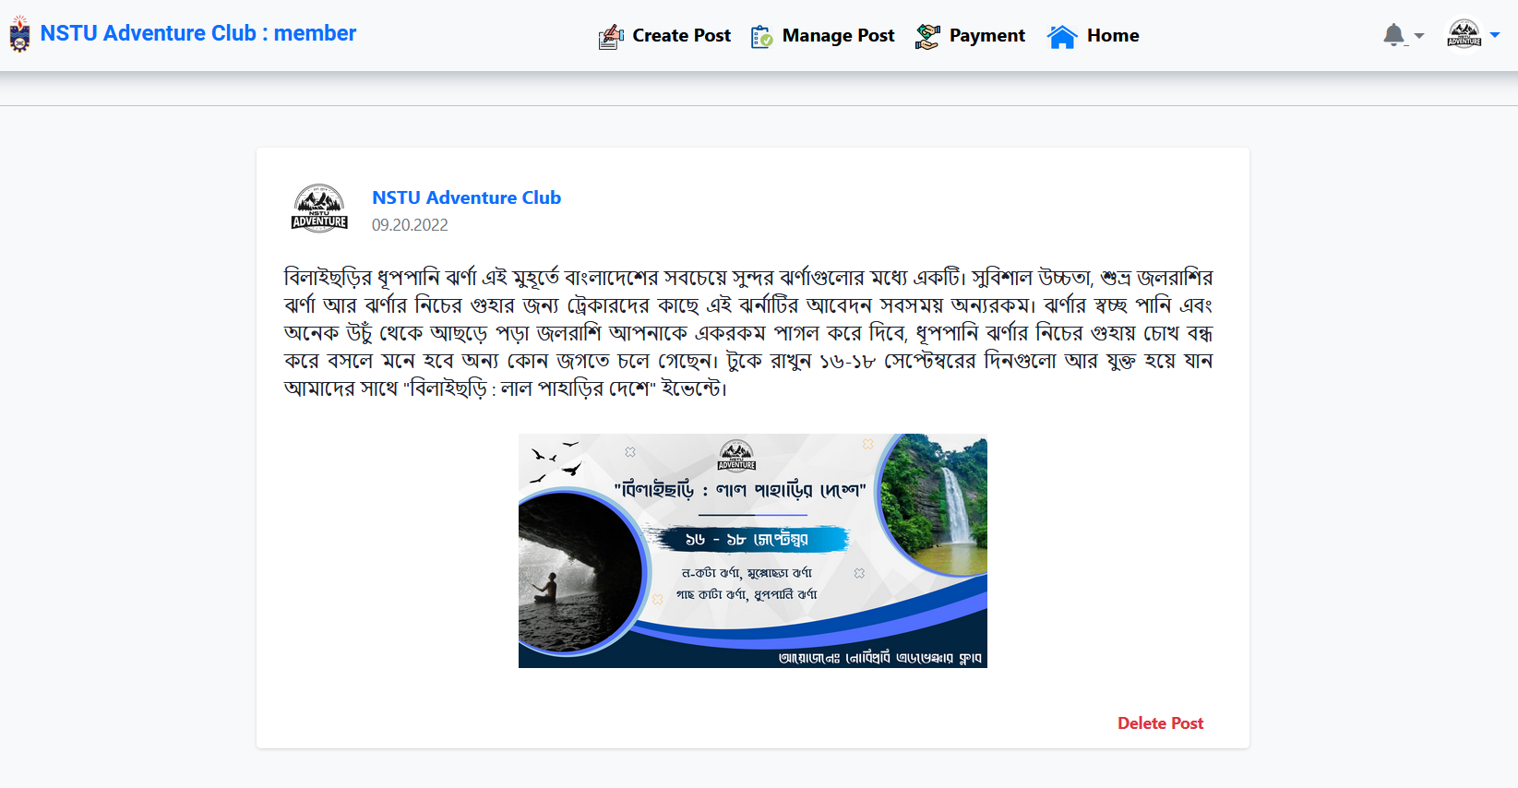
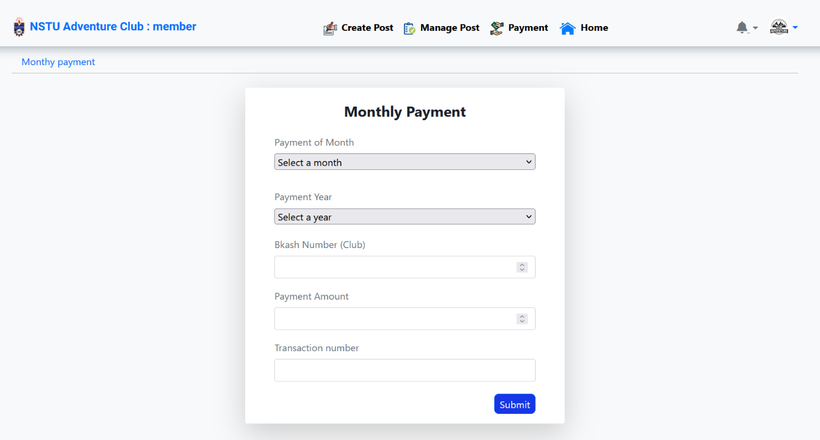
Features
NSTU Club Collab
Manage Post
Monthly payment
7

Slide 9
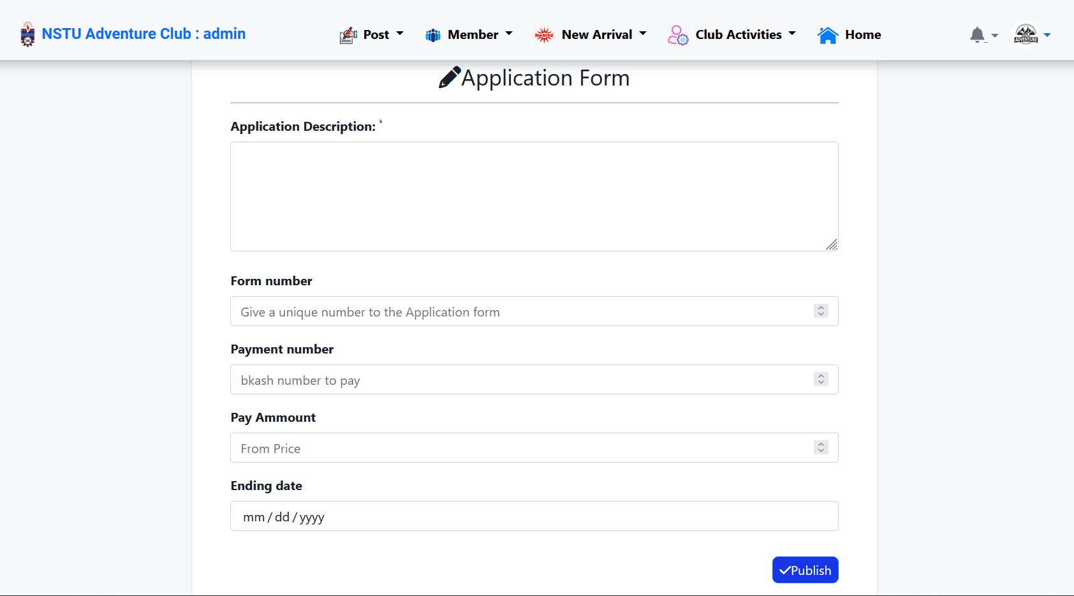
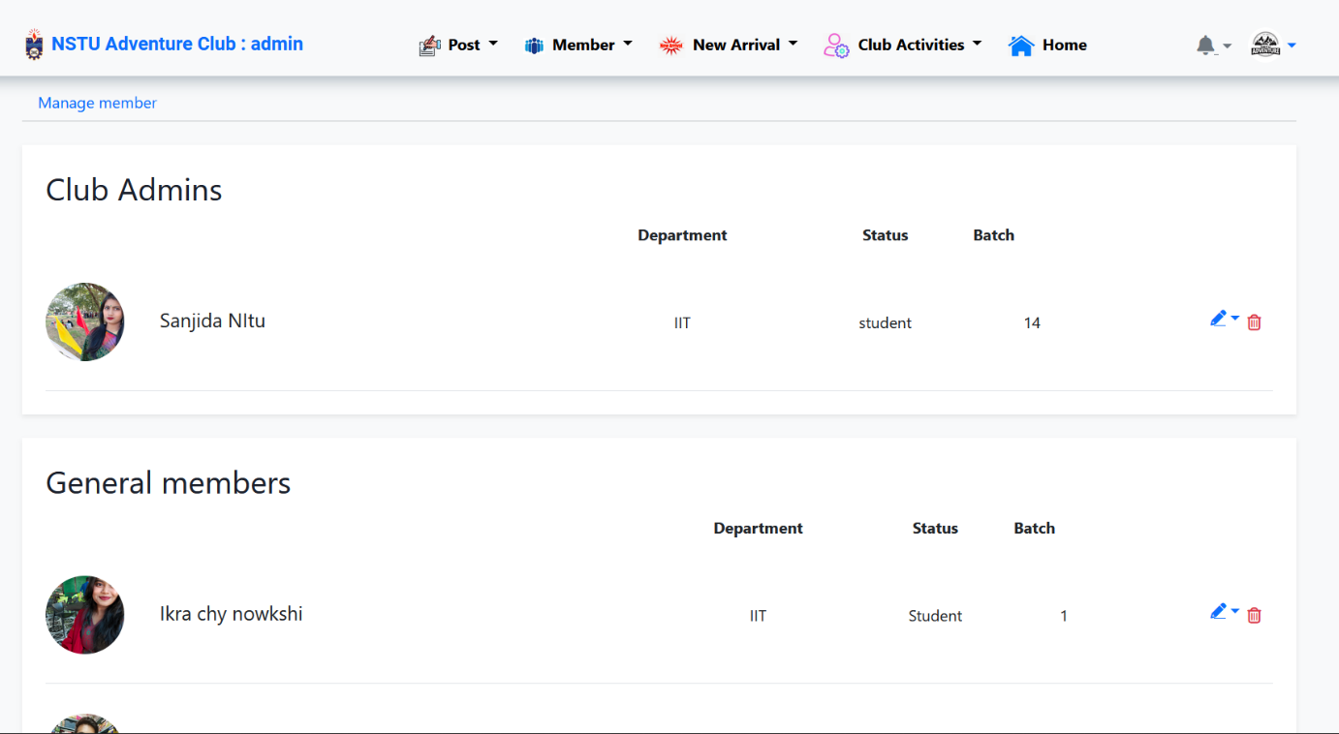
Features
NSTU Club Collab
Applicant Form
Manage member
NSTU Club Collab
8

Slide 10
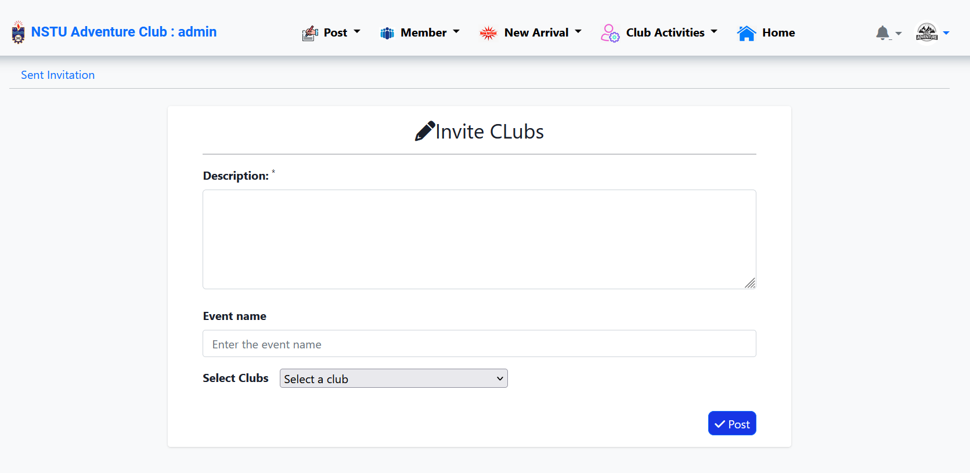
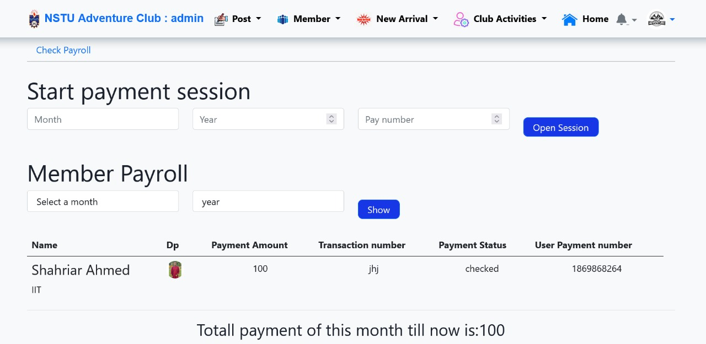
Features
Invitation
Payroll
NSTU Club Collab

Slide 11

Team Contribution
NSTU Club Collab
 |  | Active Members
Task | Module | Shahriar Ahmed | Ikra Chowdhury | Sourav Barman
Coding | Add Member , Edit Club , Payroll , Manage Applicant , Manage Member, Invitation, Form Notification, Club Register . Login, User Registration, Change Password & Forget Password [Back-end]
 | User Profile, User Feed , User Profile, Edit Profile, Join Club , Create Post, Delete Post, Leave Club, Mange Post
 | Club Activity , Home Page, Club Member. Login, Registration , Form [Front-end]
System Integration
Testing & Debugging
Slide Preparation
NSTU Club Collab

Slide 12
Thank You

